Slide 1
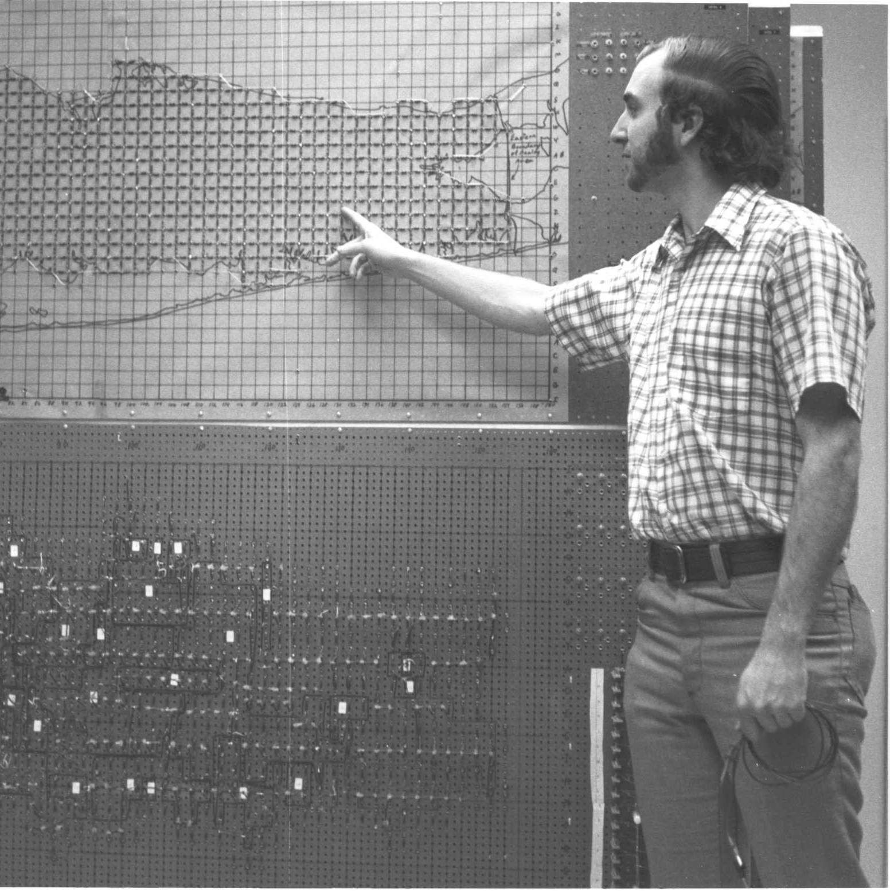
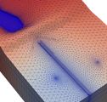
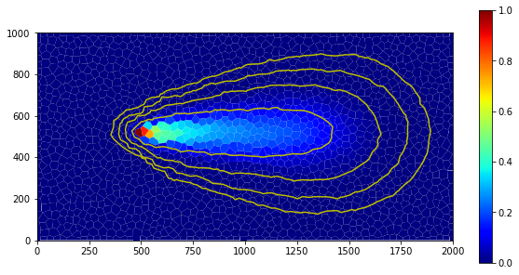



Parallel MODFLOW 6 In action
Parallel MODFLOW Training Class, July 13-14, 2023, Lakewood, CO
Notes:
Why parallel?
Different forms of parallelism, which one for MODFLOW 6?
Theoretical expectations on performance?

Slide 2
Build System
MODFLOW has traditionally been available without external dependencies: *.f90 only
Highly portable, easy to build
It still is!
And there is a more advanced version with the parallel computing capability
Other extensions from 3rd party libraries, such as NetCDF support, likely to be part of this advanced version
Parallel MODFLOW software stack:
MODFLOW 6
MPI
PETSc
…
BLAS/LAPACK
MPI
…

Slide 3
Availability
Distributed binaries | Serial | Parallel
modflow6-nightly-build
win64 | ✓ | 
mac (conda) | ✓ | 
linux (conda) | ✓ | 
modflow6/releases
win64 | ✓ | 
mac (conda) | ✓ | 
linux (conda) | ✓ | 
HPC
Denali (linux) | ✗* | ✓
Build system | Serial | Parallel
Visual Studio | ✓ | ✗
pymake | ✓ | ✗
Makefile | ✓ | ✗
Meson | ✓ | ✓
* Serial run possible but with parallel executable

Slide 4
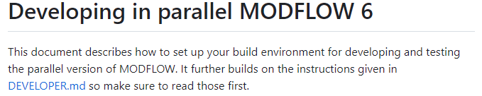
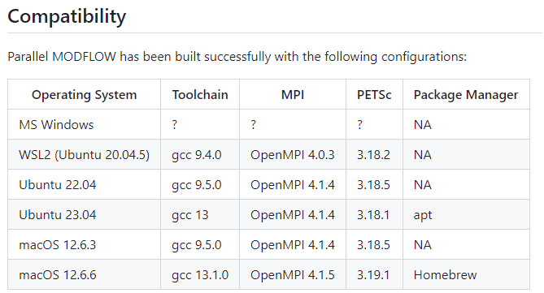
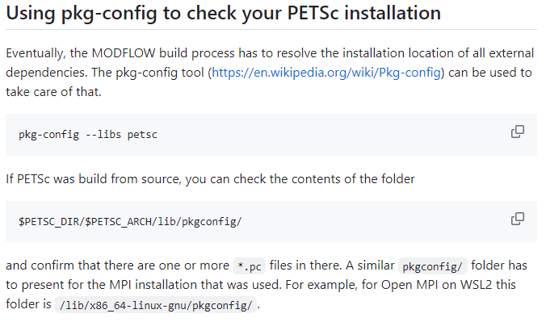
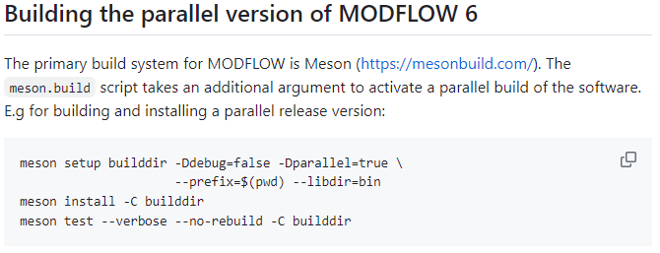
Build yourself
See PARALLEL.md in git root directory
Clear build instruction for MODFLOW 6 parallel
But, 3rd party libs via Meson dependencies are non-trivial
Many permutations possible, limited support
Document shows successful combinations
Important: use single compiler toolchain, and use single MPI implementation for all components
Notes:
Change typo in parallel in parallel.md (23.04??)

Slide 5
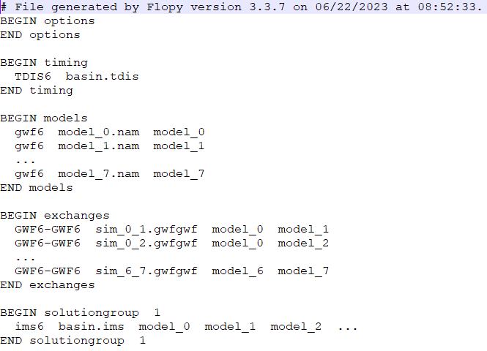
Prepare your Model
Set up a simulation as a multi-model problem
Or, split a large, existing simulation domain
with the ModelSplitter (tomorrow)
Configure the parallel solver through PETSCRC database file

Slide 6
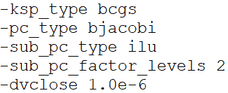
PETSc resource file
File .petscrc in same directory as mfsim.nam
Basic example:
Extremely powerful: convergence behavior, performance, switch solvers or preconditioners, attach debugger, … (see PETSc docs online)
NB: PETSc command line interface disabled
# BiCGStabilized solver
# Block-Jacobi preconditioner (parallel)
# Incomplete LU preconditioner per block
# 2 levels of fill
# Custom closure criterion (MODFLOW)

Slide 7

Run
On HPC: use job scheduler (PBS/TORQUE, SGE, Slurm)
Denali has Slurm: up next
Local, from command line:
user@pc:~$ mpiexec -np 2 mf6 –p
DEMO
Nr. of parallel processes
MPI program launcher,
(also: mpirun, orterun, …)
Parallel MODFLOW exec.
To activate parallel mode

Slide 8
DEMO (hidden slide)
Run example serial then parallel
Duplicate output to screen (Feedback)
Compare output files
mfsim.lst versus mfsim.p*.lst
Compare contents
Models and Exchanges created on the right process
Convergence synchronized (lock step) but different changes
Increase in iterations
Explain memory sizes
Show virtual memory in table
Run 4 models on 2 processes, how about on 3
Load Balancing: Tomorrow

Slide 9
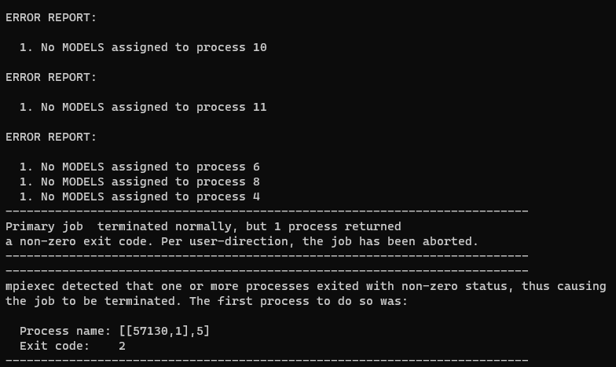
Things that can go wrong
Forget –p
Sigh… No error, but the job takes forever
Wrong number of processes –np specified
More processes than models: error
Fewer processes: no error!
Run mpiexec on serial MODFLOW executable
Forget .petscrc in simulation folder
Running parallel throws an incomprehensible exception at you: rerun in serial mode
Library cannot be found:
PATH, LD_LIBRARY_PATH
user@pc:~$ mpiexec -np 2 mf6 –p

Slide 10

Questions?

Slide 11
Validation

